Slide 1
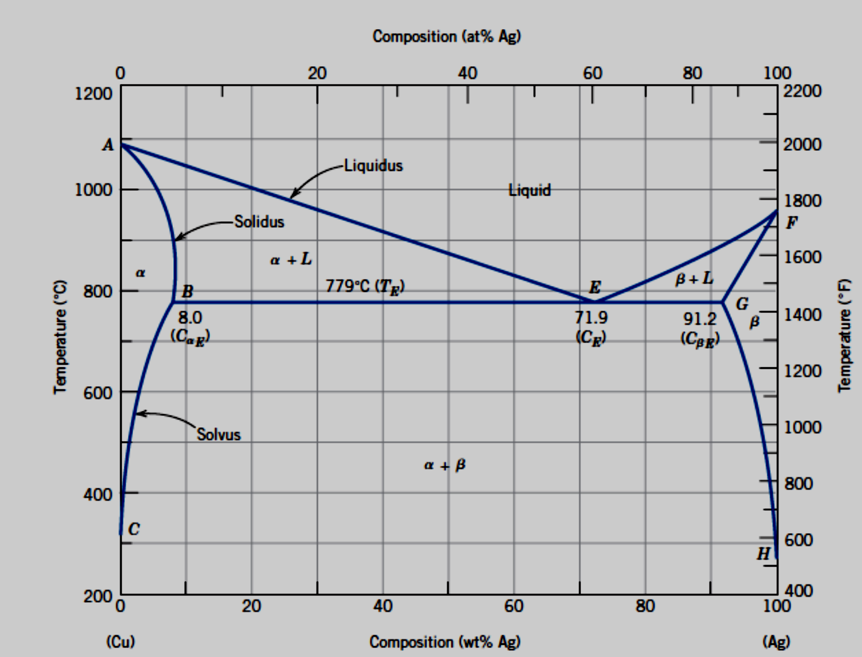
Figure 26 Cu –Ag a binary eutectic phase diagram

Slide 2
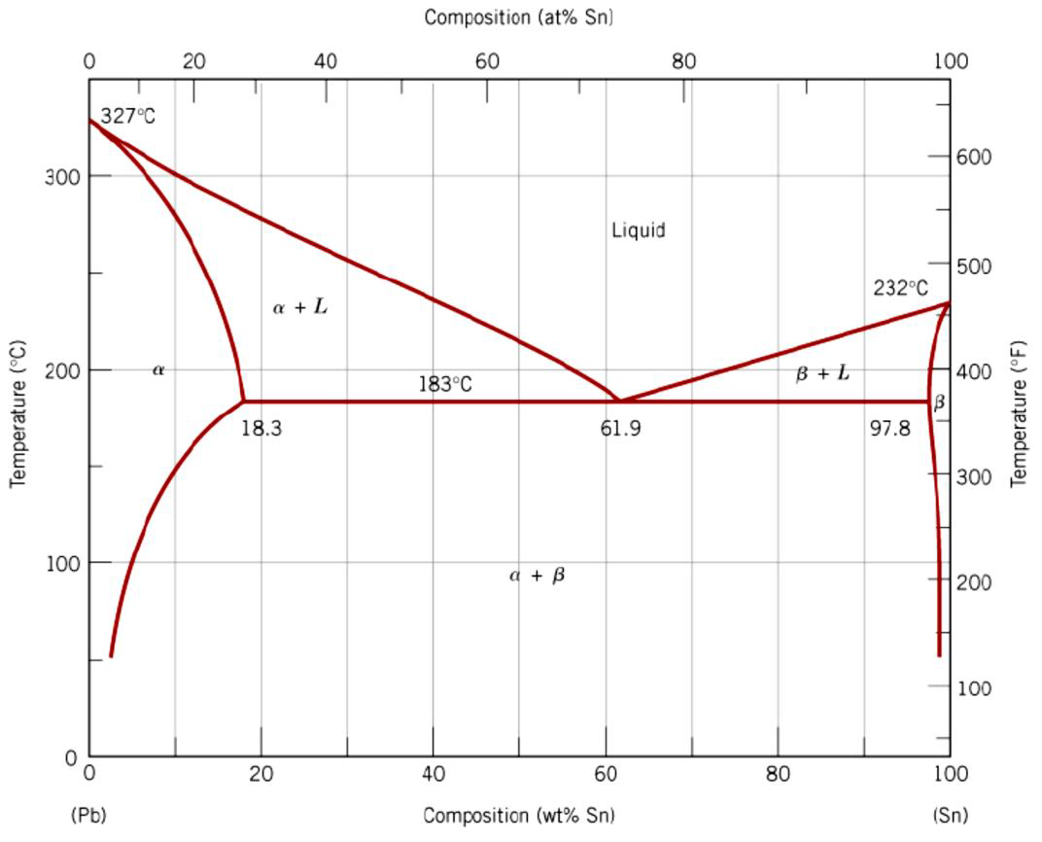
Another example for this type of phase diagram is Pb –Sn system which is given below:

Slide 3
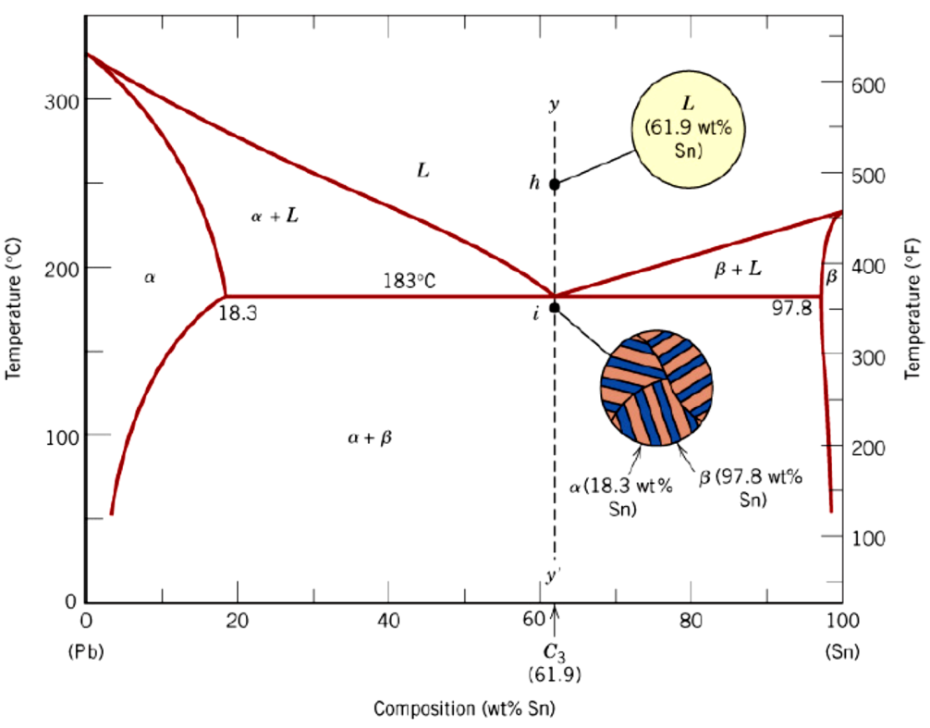
Figure 27 Pb –Sn a binary eutectic phase diagram

Slide 4
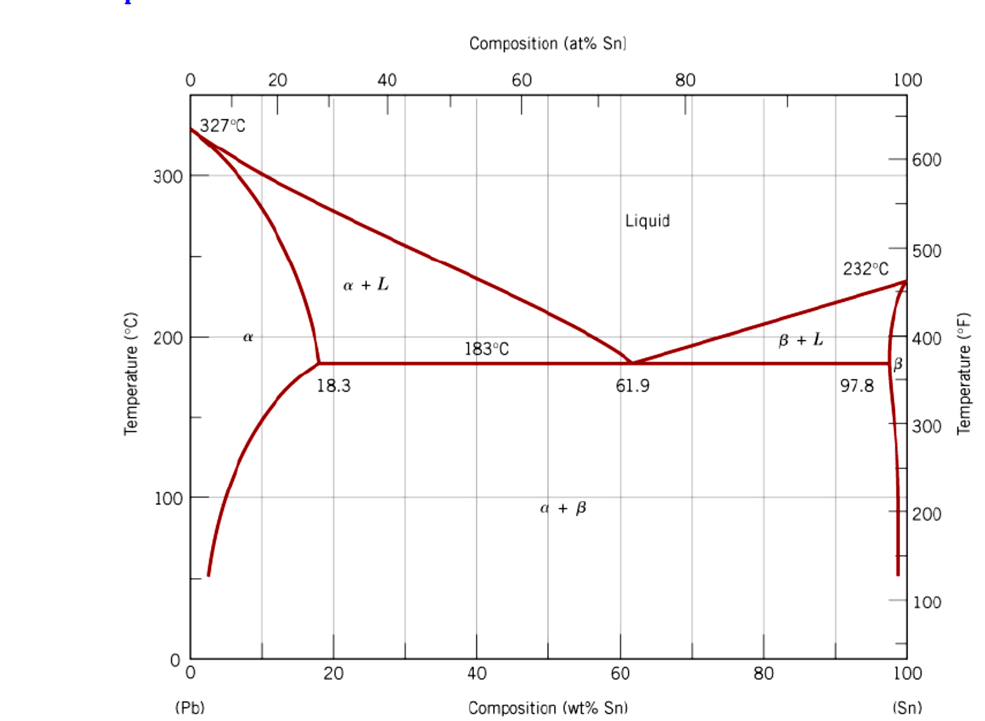
Example problem

Slide 5
Calculate the amount of each phase present in 1 kg of a 50 wt.% Pb- 50 wt.% Sn alloy at a) 300°C, b) 200°C and c) 100°C. Also calculate the amount of each microstructure.
a) For a 50 wt.% Pb- 50 wt.% Sn alloy at 300°C, we are in the liquid (L) region of the phase diagram. Therefore, we have 1 kg of liquid (L). The liquid is also the microstructure.
b) For a 50 wt.% Pb- 50 wt.% Sn alloy at 200°C, we are in the solid + liquid (α+L) region of the phase diagram. Here we must use the lever rule to calculate the mass fraction of each phase. If we draw a tie line across the α+L region at 200°C, the endpoints are at about 17 wt.% Sn and 54 wt.% Sn. Therefore, the mass fractions are:

Slide 6
Again, note that the numerator of each quantity contains the composition of the opposite phase, but this must be true in order to obtain mostly liquid (L) phase. Looking at the tie line, the composition of interest (50 wt.% Sn) is much closer to the liquid (L) than to the solid (α) phase, so mL >> mα. In addition, the two mass fractions (0.89 and 0.11) sum to 1.
Note that the two microstructures that exist here are the same as the two phases, liquid and α solid solution.

Slide 7
c) For a 50 wt.% Pb- 50 wt.% Sn alloy at 100°C, we are in the α + β region of the phase diagram. Drawing a tie line across this region of the phase diagram, the endpoints are at about 98 and 5 wt.% Sn. Therefore, the mass fractions are:

Slide 8
Here the microstructure differs from the phase, and this is determined by what happens just above the eutectic temperature, 183ºC. First, note that we on the left side of the eutectic composition, 61.9 wt% Sn, so the primary phase is α. Remember, the primary phase is the one that precipitates out prior to the eutectic reaction. The remaining liquid is transformed into the eutectic microstructure. Therefore:

